Slide 1
ANDROID BASED SPY MOBILE
Software
wireless
Embedded

Slide 2
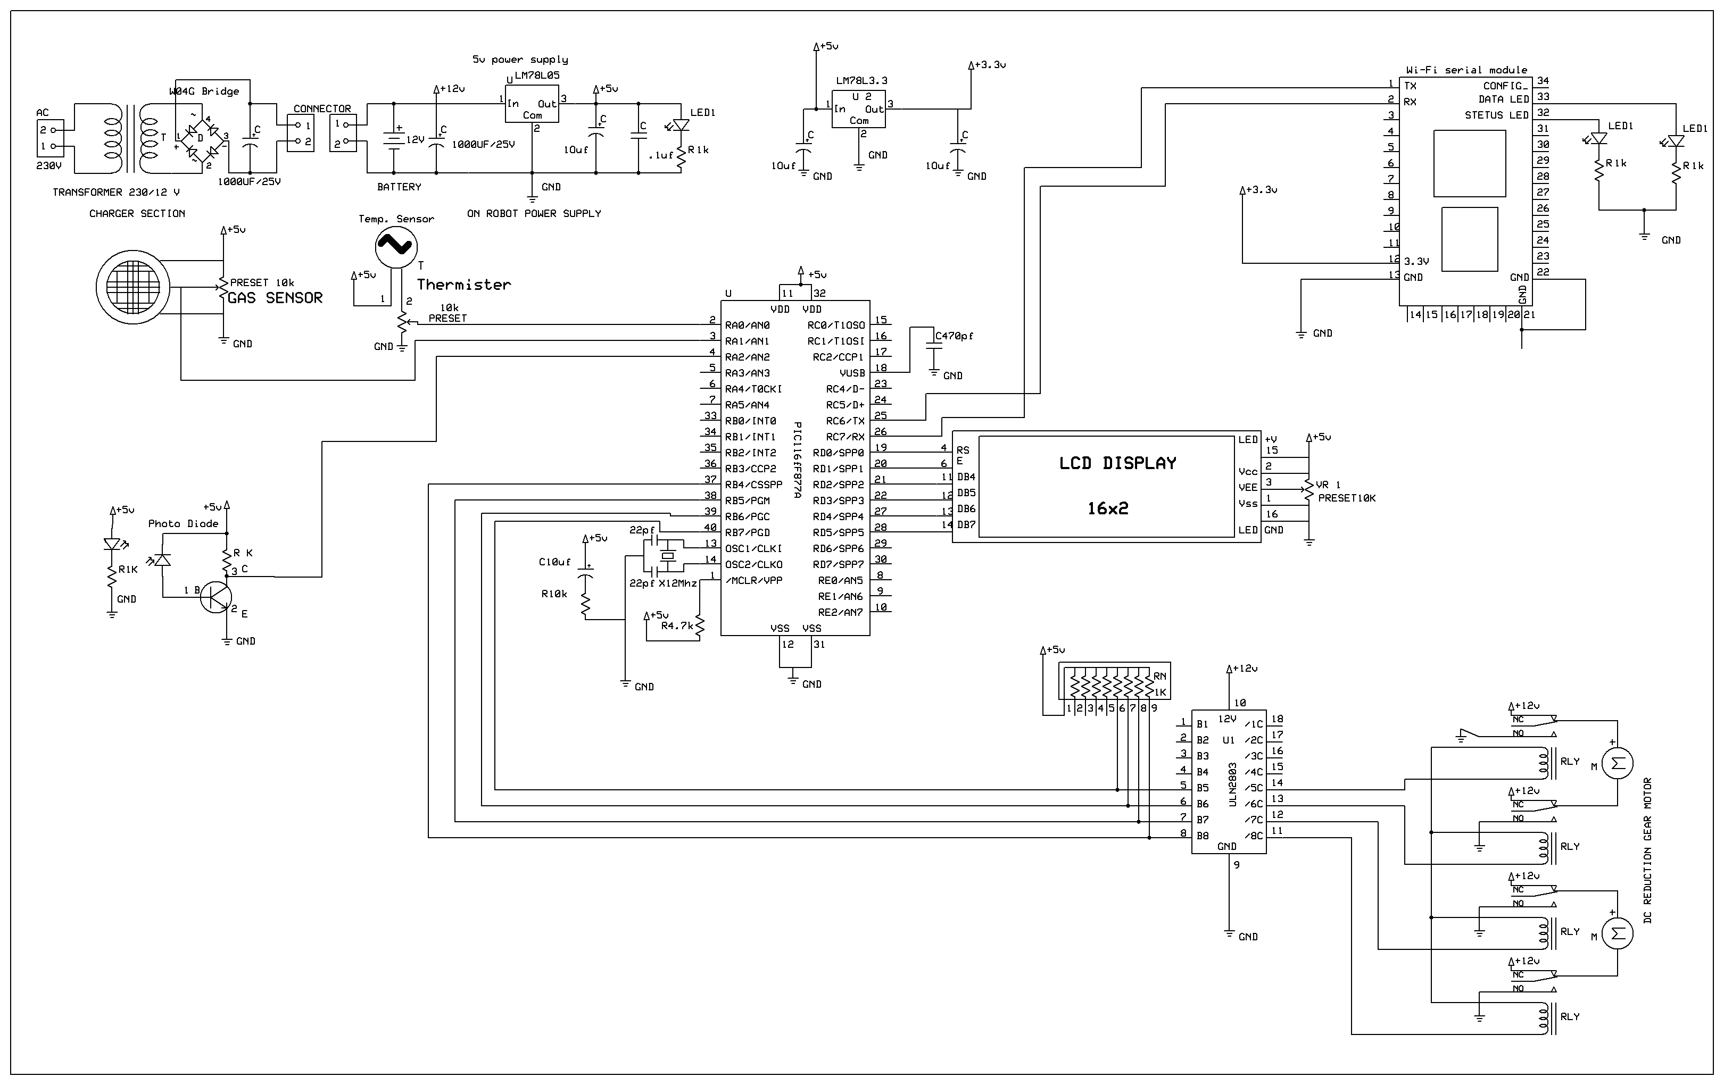

Slide 3
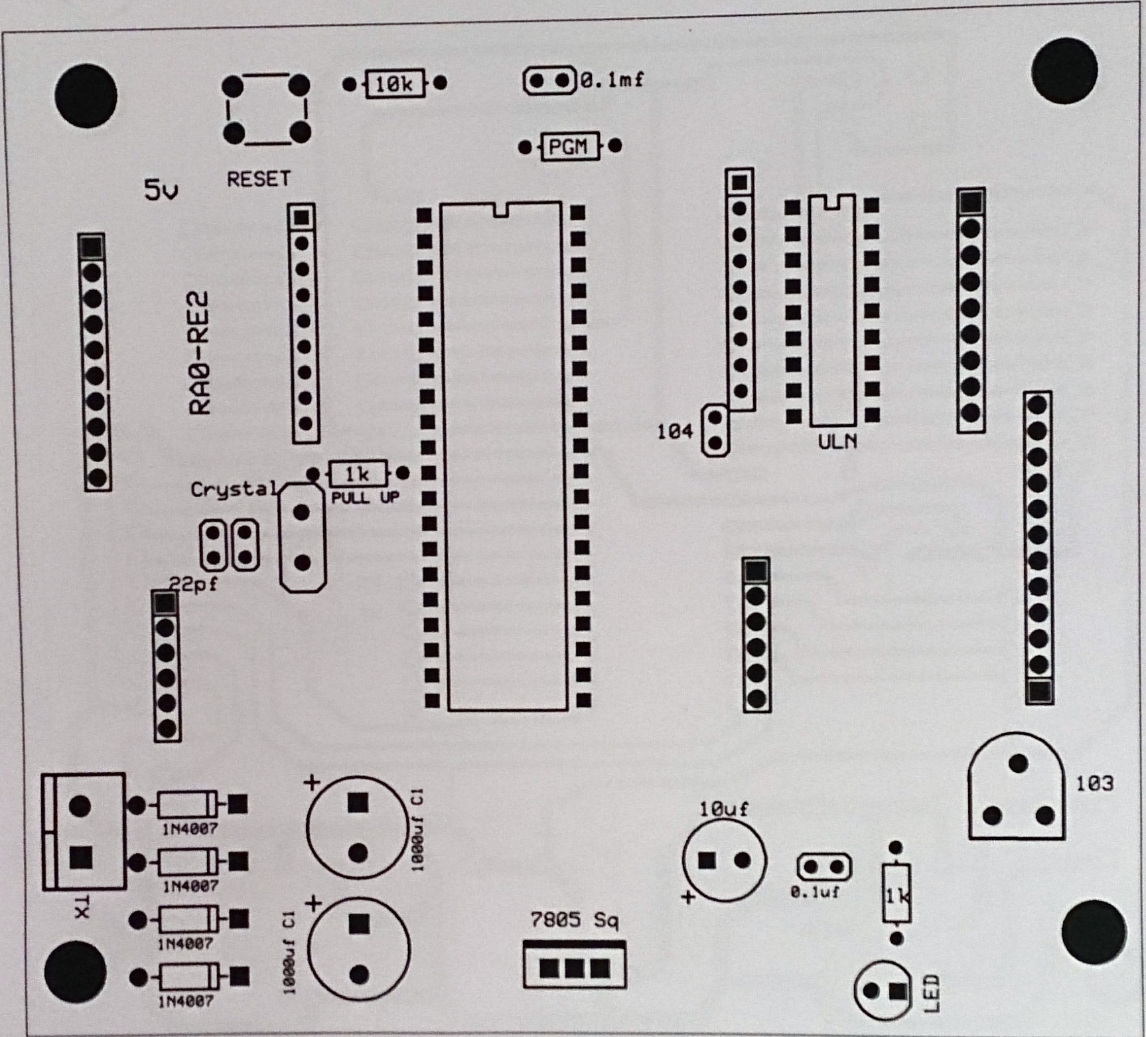

Slide 4
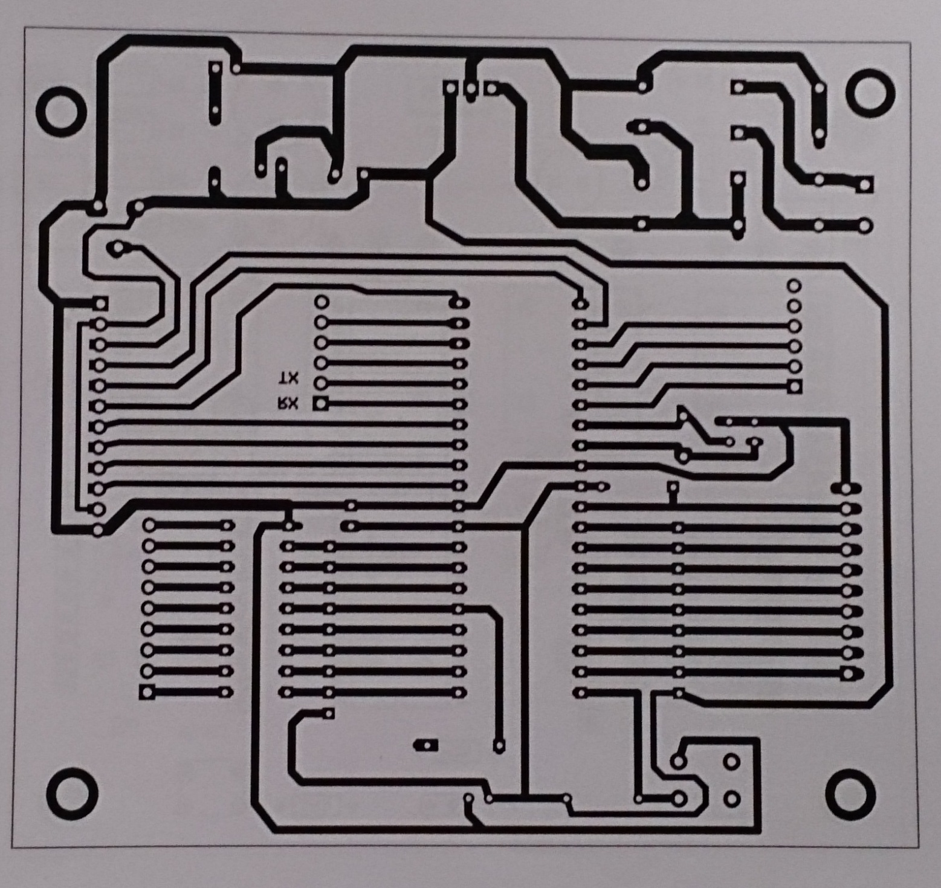

Slide 5
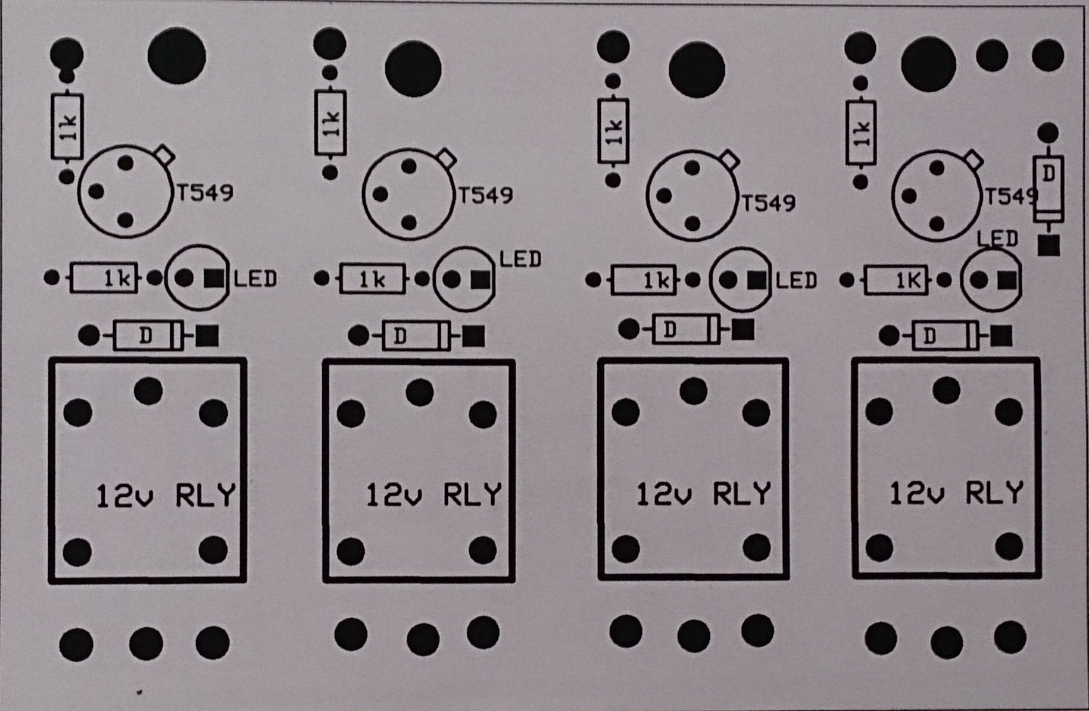

Slide 6
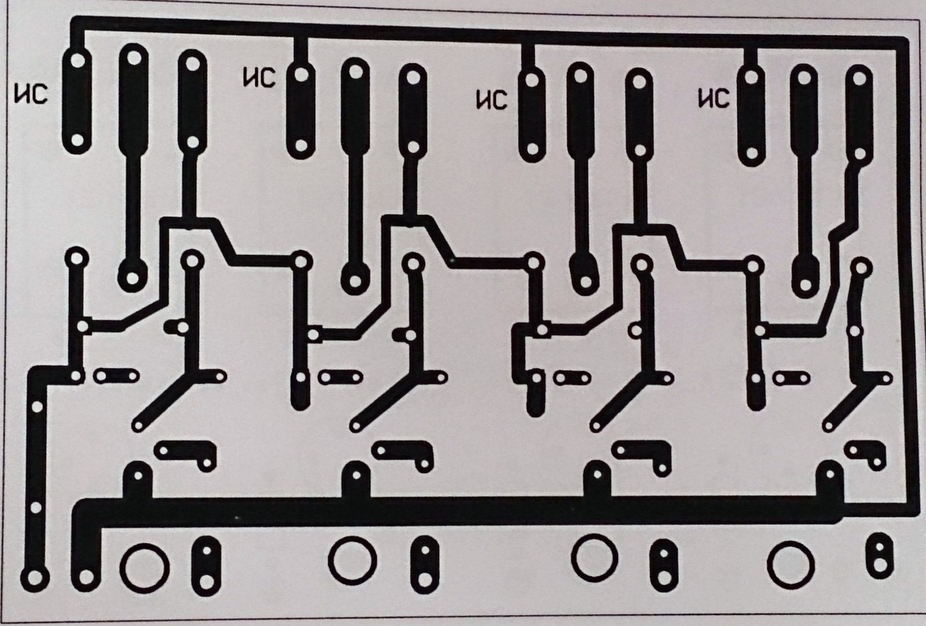

Slide 7
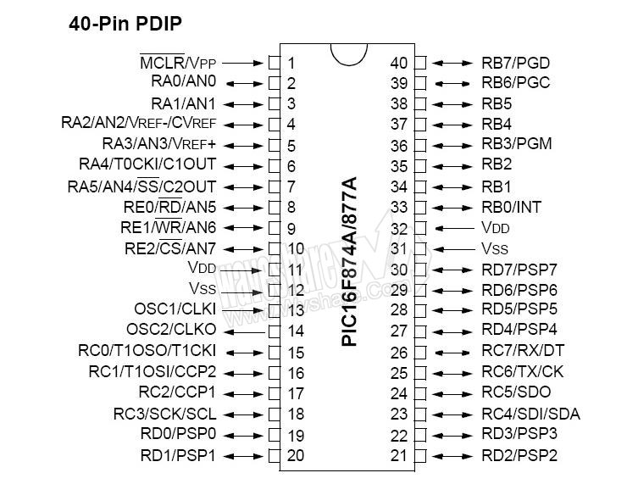
PIC16F877A Pin Diagram

Slide 8
PIC CODING
Define CONF_WORD = 0x3f72
Define LCD_BITS = 4 'allowed values are 4 and 8 - the number of data interface lines
Define LCD_DREG = PORTD
Define LCD_DBIT = 4 '0 or 4 for 4-bit interface, ignored for 8-bit interface
Define LCD_RSREG = PORTD
Define LCD_RSBIT = 0
Define LCD_EREG = PORTD
Define LCD_EBIT = 2
Define LCD_RWREG = PORTD 'set to 0 if not used, 0 is default
Define LCD_RWBIT = 1 'set to 0 if not used, 0 is default
Dim an0 As Word
Dim an1 As Word
Dim i As Byte 'declare a variable
Hseropen 9600 'open hardware uart port for baud rate 9600
TRISA = 0xff 'set all PORTA pins as inputs
TRISB = 0
RB = 0
ADCON1 = 0 'set all PORTA pins as analog inputs

Slide 9
LCD INITIALIZATION
Lcdinit 0
Lcdcmdout LcdClear 'clear LCD display
Lcdout " Android Based "
Lcdcmdout LcdLine2Home
Lcdout " Spy Vehicle "
WaitMs 2000
Lcdcmdout LcdClear 'clear LCD display
Lcdout " K.J.S.C.E "
Lcdcmdout LcdLine2Home
Lcdout " "
WaitMs 2000
Lcdcmdout LcdClear 'clear LCD display
Lcdout "Guided By:Prof:"
Lcdcmdout LcdLine2Home
Lcdout "Shilpa Vatkar "
WaitMs 2000

Slide 10
loop:
Hserget i 'wait to receive a byte on serial port
If i = "1" Then
PORTB.0 = 1
PORTB.1 = 0
PORTB.2 = 1
PORTB.3 = 0
Endif
If i = "2" Then
PORTB.0 = 0
PORTB.1 = 1
PORTB.2 = 0
PORTB.3 = 1
Endif
If i = "3" Then
PORTB.0 = 1
PORTB.1 = 0
PORTB.2 = 0
PORTB.3 = 1
Endif
If i = "4" Then
PORTB.0 = 0
PORTB.1 = 1
PORTB.2 = 1
PORTB.3 = 0
Endif
If i = "5" Then
PORTB.4 = 1
WaitMs 250
PORTB.4 = 0
Endif

Slide 11
Adcin 0, an0 't
Adcin 1, an1 'g
an0 = an0 / 4
Lcdcmdout LcdClear 'clear LCD display
Lcdout "Temperature:", #an0, "'C "
Lcdcmdout LcdLine2Home
Lcdout "Gas:", #an1, " PPM" 'formatted text for line 2
'Hserout "T", #an0, CrLf
'Hserout "G", #an1, CrLf 'send formatted output to serial port
WaitMs 50
Goto loop 'loop forever
End
If i = "6" Then
PORTB.5 = 1
WaitMs 250
PORTB.5 = 0
Endif
If i = "0" Then
PORTB.0 = 0
PORTB.1 = 0
PORTB.2 = 0
PORTB.3 = 0
Endif

Slide 12
WIRELESS CAMERA-
JMK WS-309AS

Slide 13
Technical Parameters of Transmitting Unit
Video Camera Parts: 1/3" 1/4" Image Sensors
System: PAL/CCIR NTSC/EIA
Effective Pixel: PAL: 628X582 NTSC: 510X492
Image Area:PAL: 5.78X4.19mmNTSC: 4.69X3.45mm
Horizontal Definition: 380 TV Lines
Scanning Frequency: PAL/CCIR: 50HZNTSC/EIA: 60HZ
Minimum Illumination: 3LUX
Sensitivity: 18DB-AGL ON-OFF
Output Electrical Level: 50MW
Output Frequency: 1.2G/2.4G
Transmission Signal: Video, Audio
Linear Transmission Distance: 50-100M
Voltage: DC 9V
Current: 300mA
Power Dissipation:<=640MW

Slide 14
Technical Parameters of Receiving Unit
Receiving Method:Electronic
Frequency Modulation
Reception Sensitivity: 18DB
Receiving Frequency: 1.2G/2.4G
Receiving Signal: Video, Audio
Voltage: DC 12V
Current: 500mA

Slide 15
WiFi Serial Module-
HILINK – RM04

Slide 16
No. ▾ | Function | RT5350 Pin | Direction | Explanation
1 | VDD5V | - | Power In | 5 Power input
2 | GND | - | GND | Power GND
3 | WLAN_LED | WLAN_LED_N | O | WIFI LED
4 | 3.3V | - | Power Out | 3.3V power output
5 | LINK1 | EPHY_LED3_N | I/O | Net gape 1 LED indicte
6 | USB_P | UPHY0_PADP | D | USB signal D-
7 | USB_M | UPHY0_PADM | D | USB signal D+
8 | I2S_SD | I2C_SD | I/O | I2C DATA / GPIO1
9 | I2S_CLK | I2C_SCLK | I/O | I2C CLK / GPIO2
10 | GIOP0 | GPIO0 | I/O | Universal GPIO
11 | TXOP1 | EPHY_TXP_P3 | I/O | Net gape 1 TX-P, Pin 1
12 | TXON1 | EPHY_TXN_P3 | I/O | Net gape 1 TX-N, Pin 2
13 | RXIP2 | EPHY_RXP_P4 | I/O | Net gape 2 RX-P, Pin 3
14 | RXIN2 | EPHY_RXN_P4 | I/O | Net gape 2 RX-N, Pin 6
15 | RXIN1 | EPHY_RXN_P3 | I/O | Net gape 1 RX-N, Pin 6
16 | RXIP1 | EPHY_RXP_P3 | I/O | Net gape 1 RX-P, Pin 3
17 | TXON2 | EPHY_TXN_P4 | I/O | Net gape 2 TX-N, Pin 2
18 | TXOP2 | EPHY_TXP_P4 | I/O | Net gape 2 TX-P, Pin 1
19 | RTS_N | RTS_N | I | All function serial RTS / GPIO7
20 | UART_RX | RXD2 | I | Simple serial RX / GPIO16
21 | UART_TX | TXD2 | O | Simple serial TX / GPIO15
22 | RXD | RXD | I | All function serial RX / GPIO10
23 | LINK2 | EPHY_LED4_N | I/O | Net gape 2 LED I/O indicte
24 | CTS_N | CTS_N | O | All function serial CTS / GPIO9
25 | RIN | RIN | I | GPIO14
26 | TXD | TXD | O | All function serial TX / GPIO8
27 | 1.8V | - | Power Out | Net gape 1.8V output
28 | VDD5V | - | Power In | 5V input

Slide 17
Network standard | wireless：IEEE 802.11n、IEEE 802.11g、IEEE 802.11b
 | wired：IEEE 802.3、IEEE 802.3u
Wireless transmission rate | 11n: maximum up to 150Mbps 11g: maximum up to 54Mbps 11b: maximum up to 11Mbps
Tracks number | 1-14
Frequency range | 2.4-2.4835G
Emission power | 12-15DBM
Interface | 1个10/100Mbps LAN/WAN multiplex interface、interface
Antenna
Antenna type | Onboard antenna / External Antenna
Functional Parameters
WIFI work mode | Client/AP/Router
WDS Function | Support WDS wireless bridge connection
Wireless security | Wireless MAC address filtering
 | Wireless security function switch
 | 64/128/152 bit WEP encryption
 | WPA-PSK/WPA2-PSK、WPA/WPA2 security mechanism
Network management | Remote Web management
 | Configuration file import and export
 | WEB software upgrade
Technical Specifications
Serial to Network
Maximum transmission rate | 230400bps
TCP connection | Max connection number>20
UDP connection | Max connection number>20
Serial baud rate | 50~230400bps
Other Parameters
Status indicator | Status indicator
Environmental standard | Operating temperature：-20-70℃
 | Operating humidity：10%-90%RH
 | Storage temperature：-40-80℃
 | Storage humidity：5%-90%RH
Additional properties | Frequency bandwidth optional：20MHz、40MHz ,Auto

Slide 18
TV Tuner Specifications
Model ID: IT-TV 150 FM(USB Stick)
Device type: External (TV Tuner Stick) for PC, Laptop
Remote Control: Yes Supported
TV Recording: Yes, TV Recording in MPEG-2, MPEG-4 (H.264) formats
S-Video In: Yes
USB: USB 2.0
Additional features: Reach 30 frames per minute with the resolution 720x480(NTSC DVD),reach 25 frames per minute with the resolution 720x576(PAL DVD).

Slide 19
Power Supply Section
Two 6volts battery connected in series=12volts.
Power Supply on-off switch.
Capacitor filter.
7805 voltage regulator.
Capacitor filter.
Spike suppreser.
Power supply indication LED.
Current limiting resistor.

Slide 20
MOTOR AND RELAY SPECIFICATIONS
The output of port B of PIC16 is weak and hence is pulled up by 10kohm resistor.
This output is given to transistors BC547 that amplifies the signal magnetizing relay coils.
Relays are 12 volts SPDT (SINGLE POLE DOUBLE THROW) .
Motor movement is controlled by port B output through Relays.
Four motors driving wheels are 12volts DC REDUCTION GEAR MOTOR.(60 rpm)
Two of these motors are connected parallely.
ARM movement is controlled by a 12 volt DC REDUCTION GEAR MOTOR of 5 RPM.

Slide 21
Sensors
TEMPERATURE SENSOR
GAS SENSOR
Connected to port A.0
Specifications:
2.2 to 100K Ohms Resistance @25ºC
Proven Stability and Reliability
30AWG Solid Tin Plated Copper Leads
Thermally Conductive Epoxy Coating
Temperature Range -40ºC to +125ºC
Available in Custom Tolerances
RoHS Compliant
Connected to port A.1
Specifications:
Power supply needs: 5V
Interface type: Analog
Pin Definition: 1-Output 2-GND 3-VCC
High sensitivity to LPG, iso-butane, propane
Small sensitivity to alcohol, smoke
Stable and long life
Size: 40x20mm

Slide 22
Sr. No | ITEM | Price per | Quantity | Total price
 | 7805 - 5V voltage regulator | Rs 15 | 1 | Rs 15
2. | 16x2 LCD with green Backlight | Rs 250 | 1 | Rs 250
3. | Crystal (11Mhz) | Rs 50 | 1 | Rs 50
4. | 40 Pin IC Base | Rs 22 | 1 | Rs 22
5. | Transistor npn BC549 | Rs 8 | 6 | Rs 48
6. | Wifi serial module ( HiLinK-RMO4) | Rs 3300 | 1 | Rs 3300
7. | PIC-16F877A | Rs 180 | 1 | Rs 180
8. | Wireless camera (Jmk Ws-309as) | Rs 2249 | 1 | Rs 2249
9. | 12v SPDT Relay | Rs 20 | 6 | Rs 120
10. | Gas sensor MQ6 | Rs 365 | 1 | Rs 365
11. | Temp sensor 10K | Rs 25 | 1 | Rs 25
12. | PIR Sensor | Rs 380 | 1 | Rs 380
13. | 230v/12v Transformer | Rs 150 | 1 | Rs 150
14. | 2 inch Bore Wheel thick | Rs 60 | 4 | Rs 240
15. | 12V DC Red. Motor 60rpm | Rs 650 | 4 | Rs 2600
16. | Battery 6V | Rs 800 | 2 | Rs 1600
17. | TV Tuner | Rs 1080 | 1 | Rs 1080
Total : |  |  |  | Rs 12,674

Slide 23
Why android?
Powers hundreds of millions of mobile devices in more than 190 countries around the world.
Largest installed base of any mobile platform and growing fast—every day another million users power up their Android devices for the first time and start looking for apps, games, and other digital content.
Android gives you a world-class platform for creating apps and games for Android users everywhere, as well as an open marketplace for distributing to them instantly.

Slide 24
Every day more than 1 million new Android devices are activated worldwide.
Android’s openness has made it a favorite for consumers and developers alike, driving strong growth in app consumption.
Android users download more than 1.5 billion apps and games from Google Play each month.
Android is continuously pushing the boundaries of hardware and software forward to bring new capabilities to users and developers.
For developers, Android innovation lets you build powerful, differentiated applications that use the latest mobile technologies.

Slide 25
Why use android in making app?
Android gives you everything you need to build best-in-class app experiences. It gives you a single application model that lets you deploy your apps broadly to hundreds of millions of users across a wide range of devices—from phones to tablets and beyond.
Android also gives you tools for creating apps that look great and take advantage of the hardware capabilities available on each device. It automatically adapts your UI to look it's best on each device, while giving you as much control as you want over your UI on different device types.
To help you develop efficiently, the Android Developer Tools offer a full Java IDE with advanced features for developing, debugging, and packaging Android apps. Using the IDE, you can develop on any available Android device or create virtual devices that emulate any hardware configuration.

